Slide 1
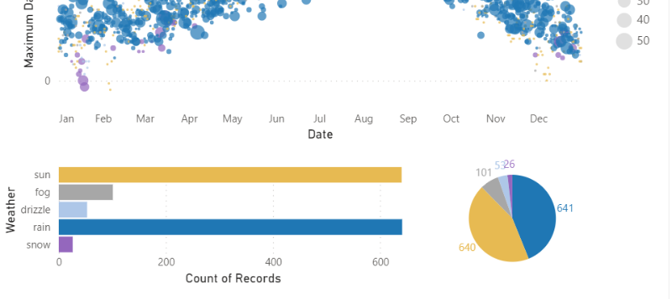
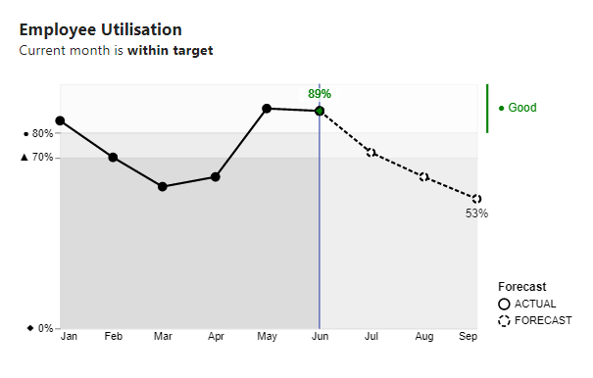
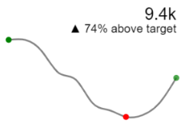
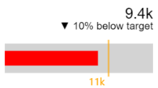
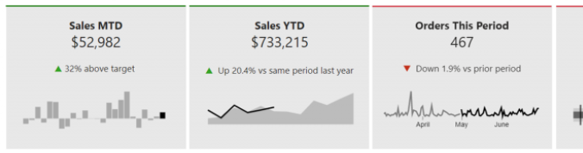
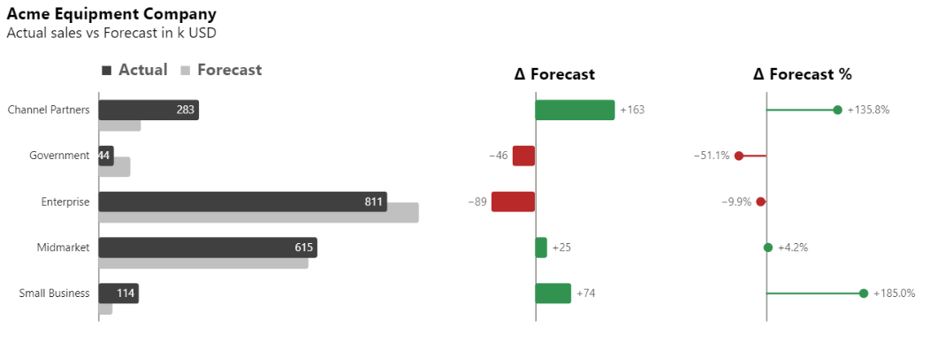
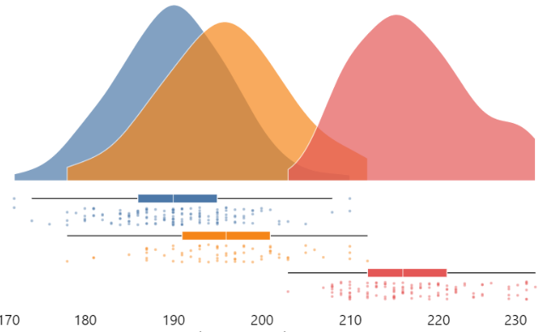
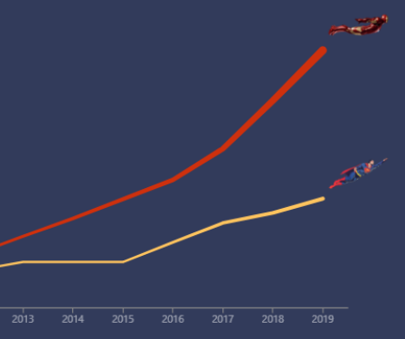
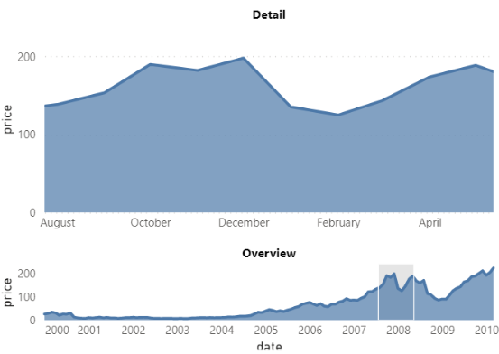
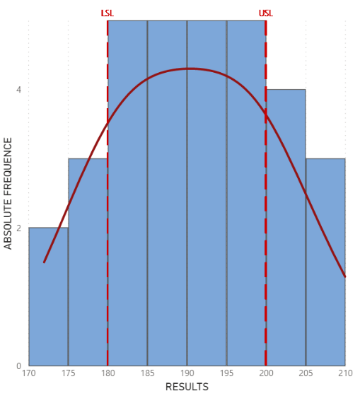
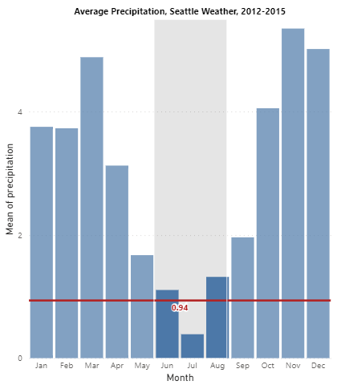
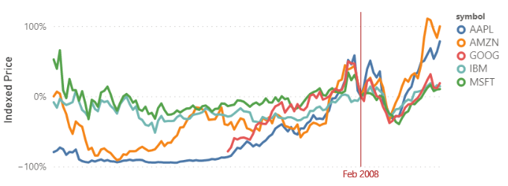
Deneb Custom Visual in Power BI
January 2023
Notes:
Links to most charts shown here:
Seattle Weather Exploration | Vega-Lite
Thinking about target bands - EXPLORATIONS IN DATA STORYTELLING WITH POWER BI (kerrykolosko.com)
https://appsource.powerbi.com/deneb.deneb7E15AEF80B9E4D4F8E12924291ECE89A.1.4.0.0.pbix
Deneb-Showcase/Variance at main · PBI-David/Deneb-Showcase (github.com)
Raincloud Plots with Deneb - EXPLORATIONS IN DATA STORYTELLING WITH POWER BI (kerrykolosko.com)
Images and custom shapes in Deneb - EXPLORATIONS IN DATA STORYTELLING WITH POWER BI (kerrykolosko.com)
Overview and Detail | Vega-Lite
Interactive Average | Vega-Lite
Interactive Index Chart | Vega-Lite

Slide 2
Agenda
Deneb Overview
Why Deneb?
What is Deneb?
Demo Charts
Vega
Cautions
Demo – Creating a chart
Q + A

Slide 3

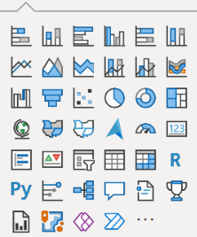
Finding the right visual
Notes:
To make a great dashboard, you start from the standard visuals in Power BI. They are pretty good!

Slide 4
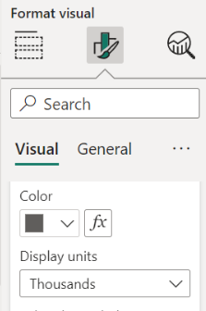
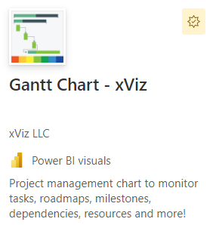
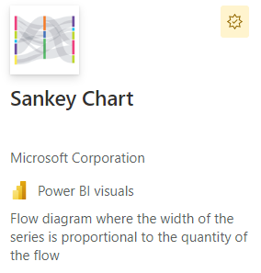
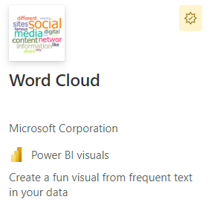
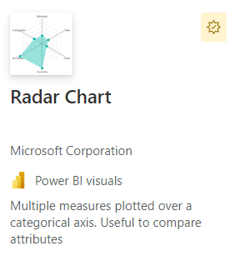
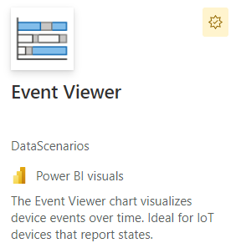
Finding the right visual
Formatting
Colors, labels
Features
Gantt, Sankey, Word cloud, Radial, Radar, Events…
Waterfall using measures
Notes:
But often you find you just can’t customize every element. Your boss says “make that text red” or “make just that bar green” and you can’t do it. Or maybe you need a gantt chart or a word cloud and those visuals just don’t exist in Power BI. Or you’re using the waterfall chart, but the standard chart only works when your data is in columns, and your data is in measures.

Slide 5

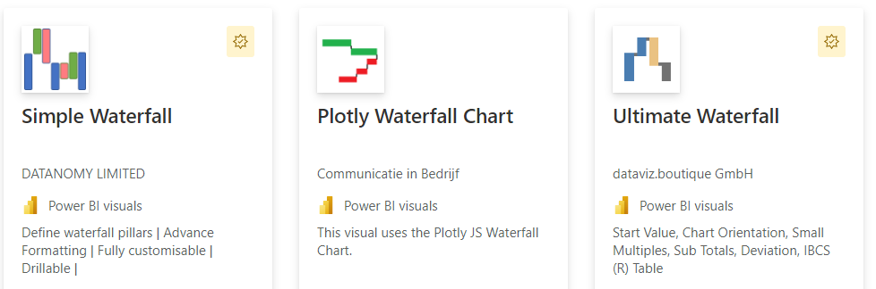
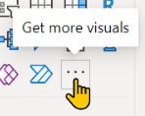
Finding the right visual
Notes:
When you hit these limitations of the standard Power BI visuals, your next step is to click the “Get more visuals” button and search AppSource. There’s a lot to look at, but often, as in the case of my waterfall challenge, there’s a visual out there that works perfectly, though you may have to sort through a bunch to find the one you are looking for (Simple Waterfall!!!).

Slide 6
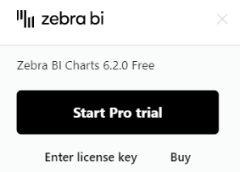
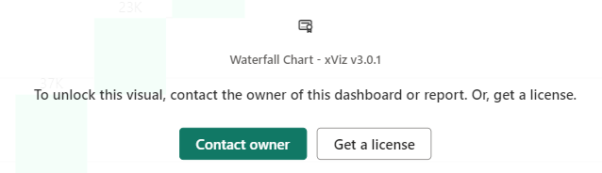
Finding the right visual
Formatting and features
License cost
Notes:
But just like the standard visuals, these visuals from AppSource only allow so much customization and may also lack features you need. And I find that the best visuals on AppSource prove the saying that “the best things in life are not free.” So what then?

Slide 7
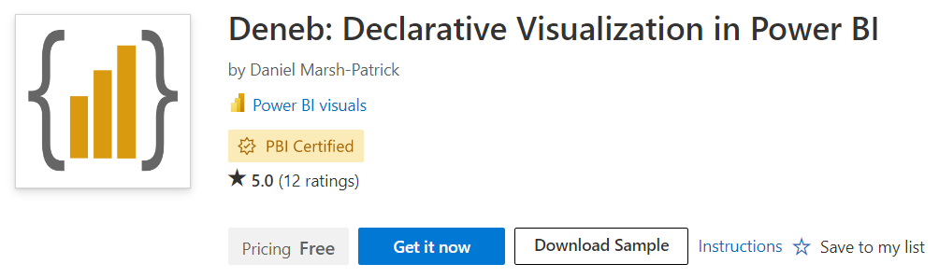
Finding the right visual
Notes:
The next place to turn is code, and my favorite solution is the free Deneb custom visual. (Which shows sometimes the best things in life are free!)

Slide 8

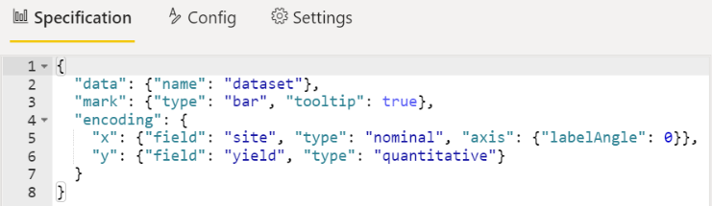
What is Deneb?
Deneb is a Power BI visual that allows you to use Vega code to create custom charts
The Vega language was designed to make the process of creating charts easy
“Excel macros for charts”
Notes:
Deneb is the name of the visual, and it allows you to use the Vega language in Power BI. Vega was created to make creating charts on the web easy. I think it’s like an Excel macro, but for charts.
I think Vega and Excel macros are a pretty good comparison.
Some of you have never touched a macro and will never touch Deneb. That’s fine, but your take-away today is to learn what the Excel/Power BI nerds are going to do with Deneb.
Some you have Googled a problem you were having in Excel and copied a macro into your file. You have no idea how it works, but you got it working to solve your problem. Today, I’m going to show you how to do that with Deneb.
Then there are those here who have recorded a macro, or tweaked one from the web, or even written your own. If you can handle that in Excel, you’ll be able to do the same kind of changes in Vega, and you’re going to love this!

Slide 9
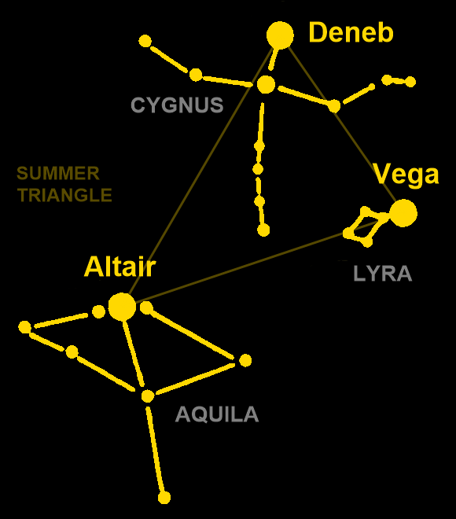
What is Deneb?
Vega is named for the brightest star in the constellation of Lyra.
The Vega implementation in Python is called Altair, the brightest star in Aquila.
Vega in Power BI is named Deneb for the brightest star in Cygnus.
Notes:
But why the name Deneb? Vega is the language, named after a star. It’s like the engine. When Vega engine is used from Python, it’s called Altair, and when it’s used from Power BI, it’s called Deneb. But the same Vega language can be used in all three places. This is great if you have a visual you want to use in a web app and on a Power BI dashboard and in Python code by your data scientists. You can develop one visual and use the exact same visual in all three places!
The great thing that they’ve named it Deneb within Power BI is that you can search on “Deneb” and find help with Vega specific to Power BI, or you can search on “Vega” when you just need help with code. It’s nice that they’ve used these star names to tie these into a common community. And if you use Deneb within Power BI, I guarantee you will be a star too!
More on the constellations can be found here:
Summer Constellations of the Northern Hemisphere (astronomytrek.com)
Famously heading the list of summer constellations are three contained within an asterism known as the Summer Triangle, which appears in the east during the early evening, before dominating the overhead sky around midnight. The three brightest stars in this arrangement are Deneb in Cygnus, Antlia in Aquila, and Vega in Lyra, with the Milky Way passing between the latter two stars in the triangle.
I want to caption this picture:
Altair: “What have you done to my lyre?!!”
Deneb: “I dunno know. It wasn’t me.”

Slide 10
Deneb strengths
Labels and lines
Conditional formatting and colors
Combo charts
Mouse interactions
Notes:
Next let’s look at some live demos of Vega charts in Power BI.

Slide 11
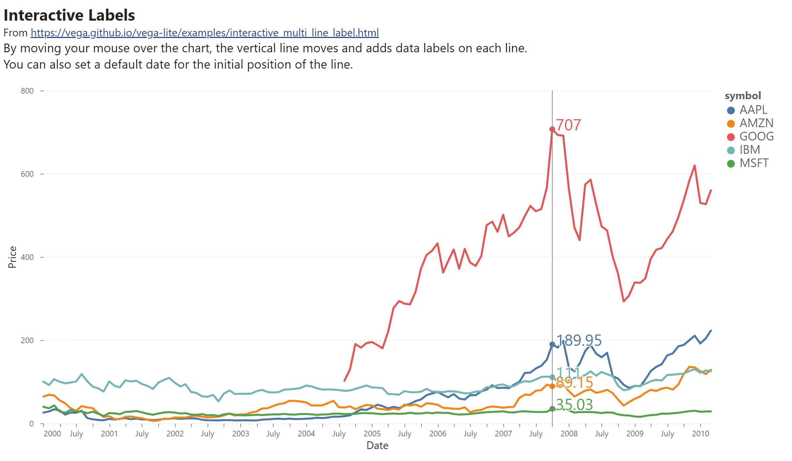
Labels and lines
Notes:
In this file, I’ve changed the live connection to static images. See the companion Power BI file.
Dynamic labels are hard to do in Power BI. In Vega, this is simple. Vega knows where the mouse is, and lets you layer lines and labels over your chart. Static lines and labels are even easier to add. Any detail in the chart can be formatted however you want.
Side story:
I’ve always said that Tableau is like an artist’s tool. You can make pixel perfect charts. Back in the day, Power BI could only make simple charts, though these days it’s easier to make nice looking charts. With Deneb, we can now make charts that are beautiful, just like Tableau.
I once had a manager who told me the limitations of Power BI visuals were not a problem, but a feature. “When I ask for someone to create me a chart in Tableau, they fuss over it for a week every time I ask for a change. When I ask for a change to a Power BI chart, I get it the same day. I don’t want my team fussing over the shade of black. Just give me a chart!”
The moral of the story is that now that Deneb puts Power BI is on par with Tableau, don’t fuss over a chart that needs to be delivered in a day. Use your new superpower wisely! My advice is to figure out which charts need Vega, make the perfect chart, turn it into a template, and never touch the code again.

Slide 12
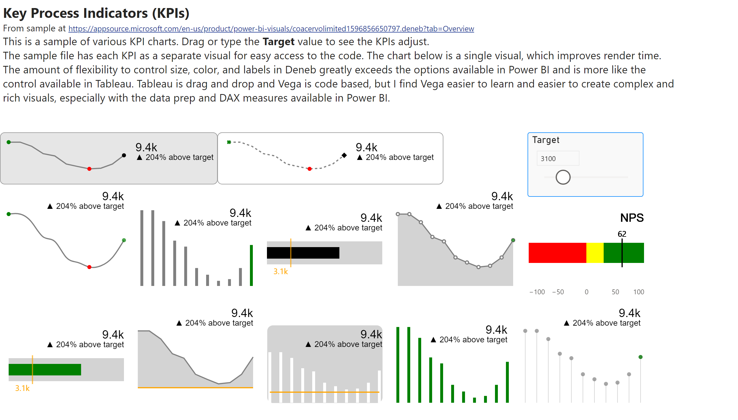
Conditional formatting / colors
Notes:
Demo: adjust the Target value using the slicer to see the KPIs update with conditional formatting.
This page has a dozen KPI visuals to show your ability to customize a chart with Vega. Except for the NPS chart, all of these are showing the same data. If you can envision it, Vega can create it.
Want lines or bars? No problem. Dots for the max and min values? Easy! All the bars the same color, or conditional formatted by month, or just the last month? Check! Text on the right or above? Just tell me where you want it and how you want it to look.
The NPS chart is great example where our metric has a “danger zone”, “watch this space”, and “success” ranges. It’s easy in Vega to set these ranges as background colors and then plot the current value.
How are these easy to create in Vega? Each chart element is specified separately and then layered on top of each other. The first chart is a line chart, and a point for the max, and a point for the min, and a point for the current value, and a text label. It makes it super easy to control the formatting on each piece of the chart.
The visuals on this page come from Kerry Kolosko in the Deneb sample file. In her version, each KPI is separate to make it easier to grab the code for the visual you want. On a dashboard, you want to combine the KPIs into a single visual. That way, the visual updates all at the same time rather than one by one. You’ll have both better performance and a better user experience.

Slide 13
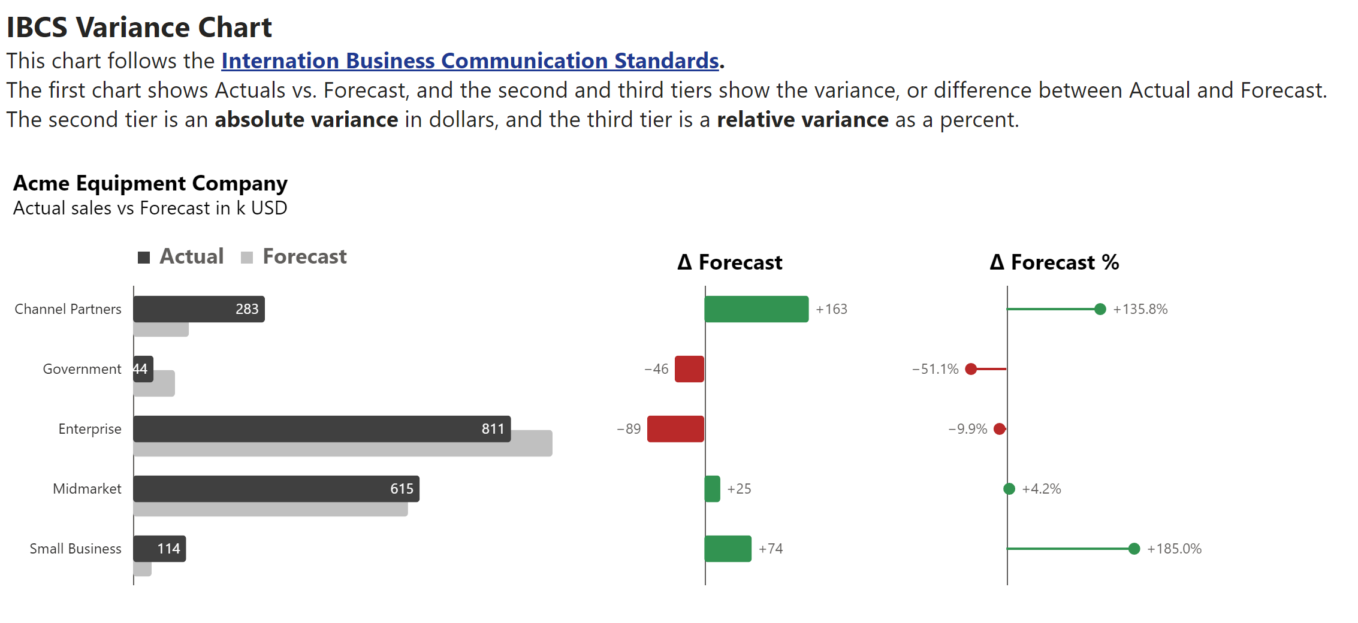
Combo charts
Notes:
I love IBCS charts, but they are impossible to make without code or paying for a license to a visual on AppSource.
With Deneb, you can create an IBCS template and use it in all your files.
The variance chart is my favorite chart. It’s like a bar chart and a waterfall chart combined. You have the first chart that allows you to focus on the current performance, but it tucks the comparison period behind it in gray. Here the comparison is Forecast, but it could also be Prior Year or Business Plan or a revised Forecast.
The middle chart is like a waterfall chart. It’s showing you the difference between actual results and the comparison period in real dollars. It makes it easy to see which category is driving performance, and all the values are labelled. This format gets all the numbers on the chart in a way that is not overwhelming.
The last chart also shows variances between actual and forecast, but this one is on a percentage basis. It’s shown as a “lollipop chart” to make it clear that these are not in dollars, like the other two charts that have solid bars. Percentages help you see that a number may be small in the big picture, but that a group is way over or under forecast.
So Vega makes combo charts easy. You can create the separate charts and concatenate them together. To create this in Power BI without Vega, you have to create three separate charts, and it doesn’t work well. When I’ve done that, I’ve found that when I filter data, sometimes the number of items that come back on each chart are different, so the labels don’t line up. Or someone sorts one of the charts and then nothing lines up anymore. With Vega, each chart shares the same axis, so they will always stay in sync.

Slide 14
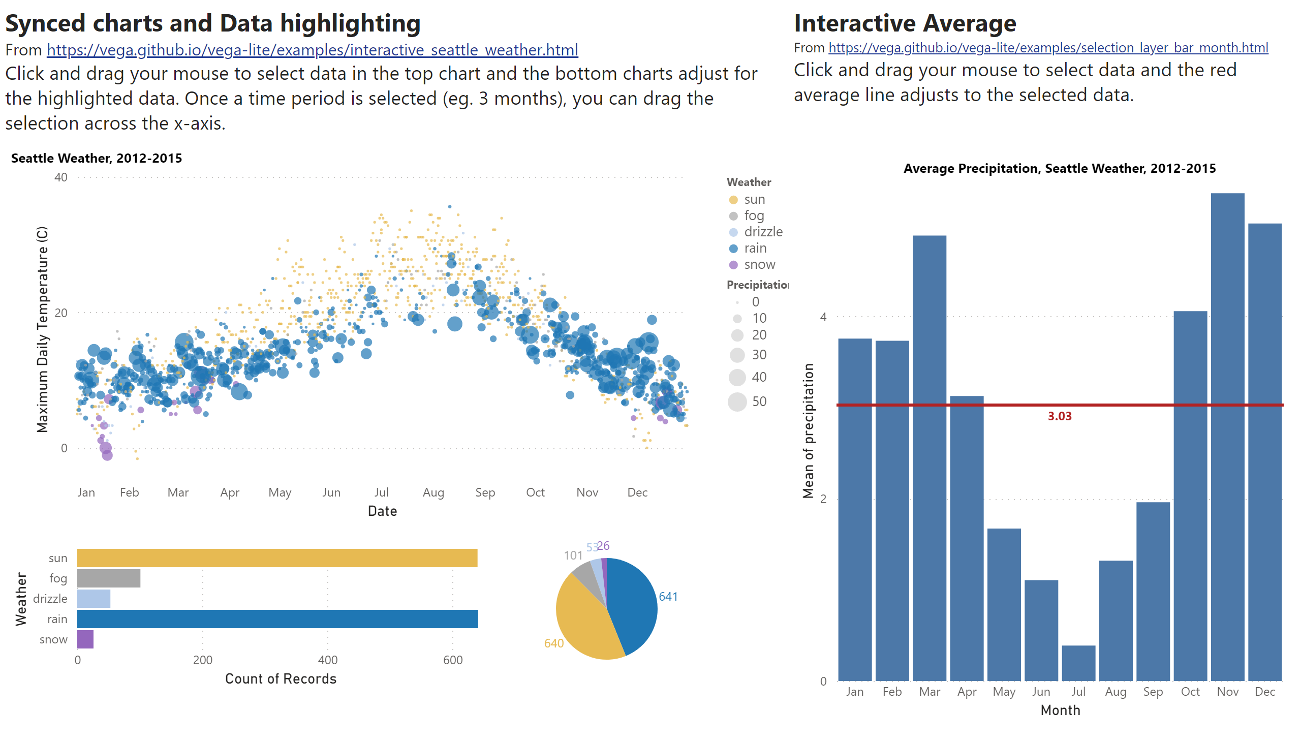
Mouse interactions
Notes:
Demo: see notes on chart for how to demo the interactions
One of the wow factors with Vega is the interactions. You can select data on the first combo chart and the other charts update, and you can drag the selection. By selecting three months and dragging it, you can see summer is sunny in Seattle, but the fall is really rainy.
On the second chart, you can see that we have a line and label showing the average precipitation for the year, but when you select a couple months, you can see the average update for the selection. Again, you can drag the selection and get the precise values for your selection.

Slide 15
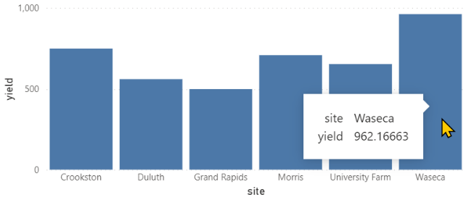
What does Vega code look like?
Notes:
Here I’m showing one of the simplest charts. The code is very straightforward.

Slide 16
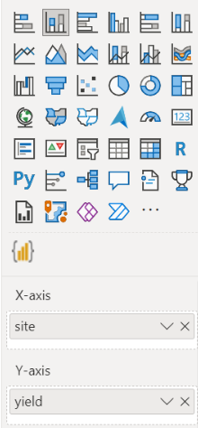
What does Vega code look like?
Notes:
If you were to create this same chart in Power BI without Deneb, you’d start by clicking the visualization type. Here I’ve selected a bar chart, but you could switch to a line chart or area chart, and Power BI would update your visual.
In Vega, these are “marks” and you can similarly change “bar” to “line” or “area” and the chart would change as well.

Slide 17
What does Vega code look like?
Notes:
In Power BI, we drag fields into the X-axis, and in Vega, these are called “encodings” and there is a “x” encoding…

Slide 18
What does Vega code look like?
Notes:
…and a “y” encoding that match our Power BI counterpart.
So if you could imagine what a Power BI visual that you are using today would look like if it were code, Vega is just that simple.

Slide 19
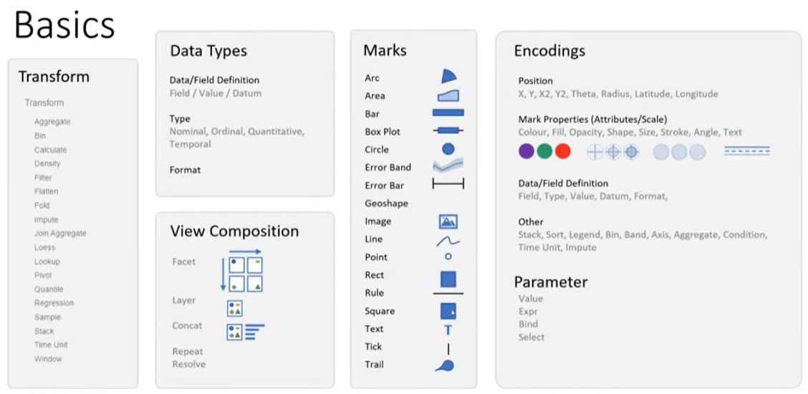
What can Vega do?
Notes:
Image from Deneb for aesthetics With Kerry Kolosko – YouTube
This chart gives you a feel for what you can do with Vega.
In the center are all the “marks” that you can use. In Vega, you rarely use just one mark, but you use layers (see the View Composition section) to combine multiple marks in a single chart. So like in the KPI sample, you might layer a Line with multiple Points and Text marks to make a chart, or as in our other charts, and Rule and Text lables to a chart.
For combo charts, you’ll use the other View Composition options, especially the Concat option to vertically or horizontally concatenate or combine separate charts.

Slide 20
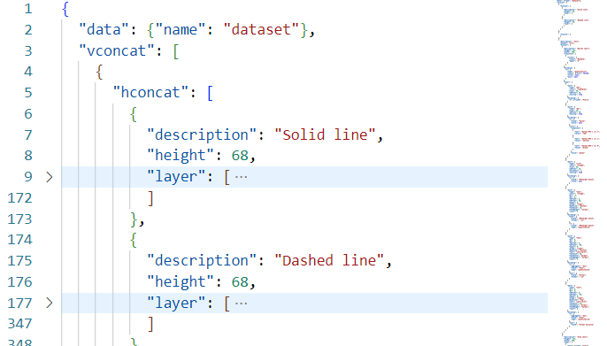
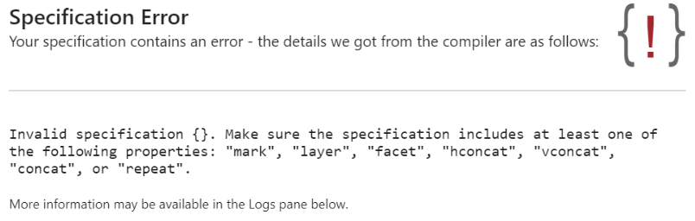
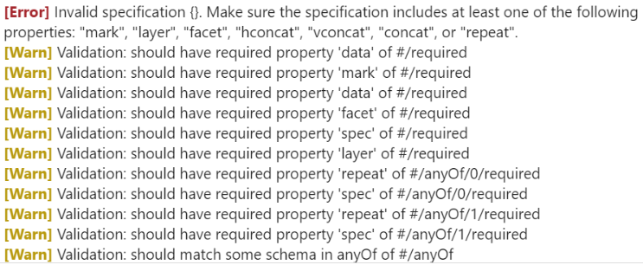
Why not Deneb?
Code is required!
Learning curve to use
Takes longer to develop
Adds to support challenge
Before using ask:
Is it really worth it?
Will I be able to fix it if it breaks?
Can more than one person on my team support this?
Notes:
So the Vega language is great for creating charts, but should I use Deneb in Power BI?
Well, think twice before you use it. It’s code. The KPI sample with 12 KPIs on a page is over a thousand lines of code. And if you have to maintain that, it will take longer than drag and drop visuals and it will break. You will see these error messages, and they really aren’t all that helpful in figuring out what’s wrong with your code. You just have to know that keywords like “vconcat” need to be enclosed in double quotes, and that you need commas between keywords, and your braces { } have to match up, just like parenthesis in your Excel formulas. These errors are just part of working with Vega code.

Slide 21
When should I use Deneb?
First ask “Why not standard/AppSource visual?”
Then ask “Who is going to support this?”
Report Type | Supported by you | Supported by team
High value / high visibility dashboards | n/a | Y
Division / Department dashboards | Maybe | Y
Team dashboard | NO!! | Y
Personal use | Y | n/a
Notes:
So before using Deneb in Power BI, first ask, why can’t I use a standard or AppSource visual. They are drag and drop, no code required. Why do I need code? For my simple bar chart example, the Deneb and Power BI versions are identical, so there is no need to use Deneb for that.
But if Deneb will add something more, then ask yourself who’s going to fix it and change it? If you have a team supporting the visual, it’s a great tool. But if it’s just you supporting the code, be careful. For your own files, it’s great. If your boss asks you for a chart that isn’t possible without Vega, have a discussion about support, and push for another person to learn how to use Vega. But for charts in your small workgroup, I don’t recommend Deneb.
Why? If one person knows how to update the code and the rest of the team doesn’t, often they need to make updates, or even just know how the chart works. They are going to be overwhelmed and frustrated by your thousand lines of KPI code. Worse yet, without any training or knowledge, they might try to update your code and break it. Or they give up and create their own file that they can actually use. All of these examples don’t end well for the team. Unless it’s really OK that you’re the only one who can update it or they know how to support Vega, just don’t do it!

Slide 22
Deneb Walkthrough
Notes:
Pause for questions.
Next we are going to walkthrough how to take a Vega sample from the web and implement it in Power BI.

Slide 23
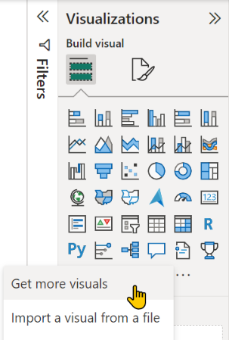
Add Deneb to Power BI
Click on the 3 dots … in the Visualizations pane and select Get more visuals
Notes:
The slides are for people after the demo. They aren’t needed during the demo.

Slide 24
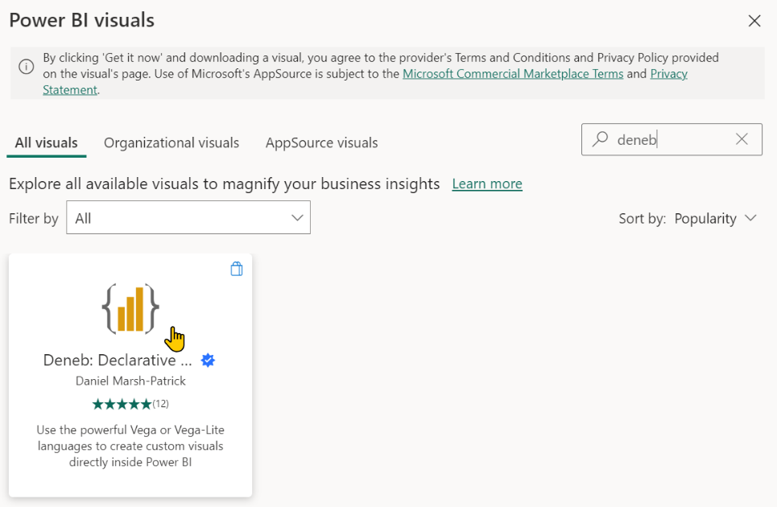
Add Deneb to Power BI
Search on Deneb and then click it
1. Search
2. Click Deneb

Slide 25
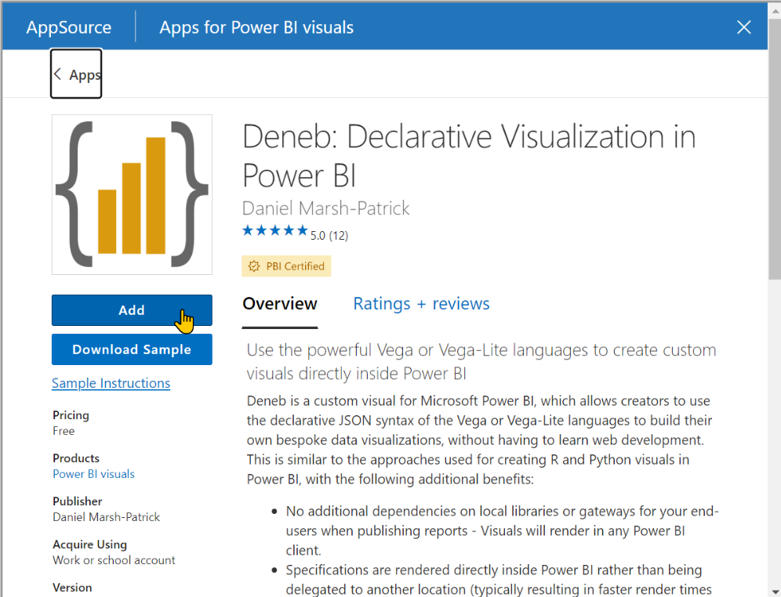
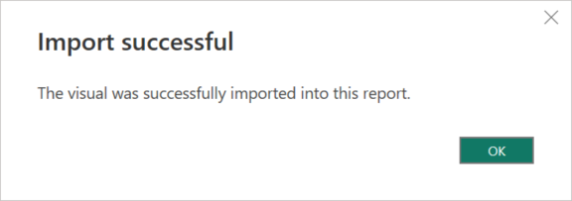
Add Deneb to Power BI
Click Add
Should receive message: “The visual was successfully imported into this report.”
Click Add
TIP: Click “Download Sample” to get a sample file showing uses of Deneb
Notes:
The sample file for Deneb has the KPI samples.
For any visual you add to Power BI from AppSource, always check out the sample file!

Slide 26
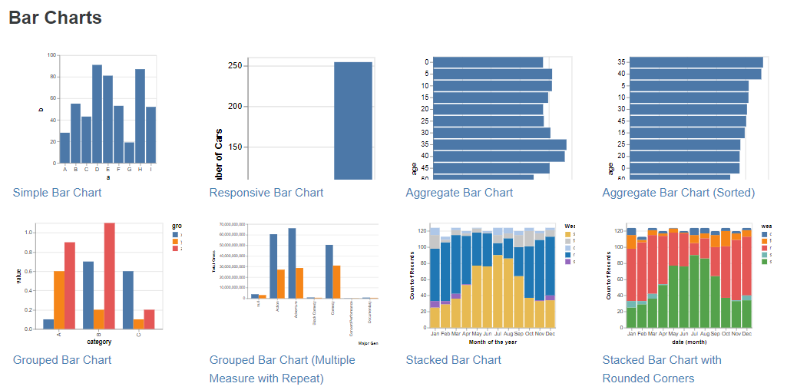
Getting a Vega example into Power BI
Example Gallery | Vega-Lite
Notes:
The official Vega website is great. It is the definitive place for samples and documentation.
“Vega-Lite” is the “easy to use” version of Vega. It gets converted to “Vega” code that is harder to read, but has more flexibility. This is behind the scenes and mostly you don’t need to worry about it. You can do great charts in “Vega-lite” without ever needing to touch “Vega”. Start with Vega-lite and you’ll know if you hit some limitation that can only be done in Vega. Deneb supports both Vega and Vega-lite.

Slide 27
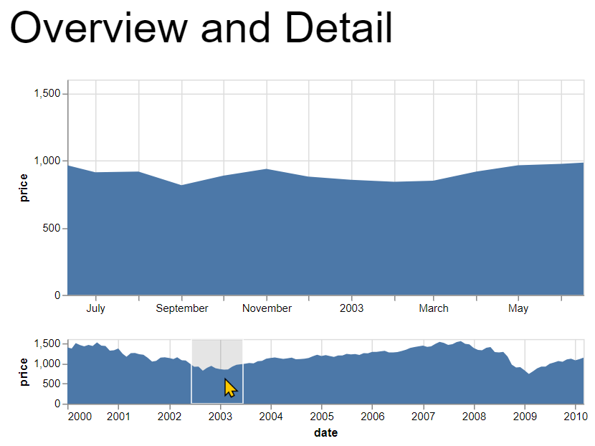
Getting a Vega example into Power BI
For this walkthrough, we are using: https://vega.github.io/vega-lite/examples/interactive_overview_detail.html
DETAIL CHART
When you select data from the Overview chart, the Detail chart dynamically changes.
OVERVIEW CHART
SELECTION
Notes:
Demo: scroll through visuals on the Examples page.
From the website, you can try out any of the visuals. Not only does each chart page have a working, interactive version of the chart, but the code to create the chart is below it. If you want to test changes, click the link to View this example in the online editor.
For this demo, we are going to implement the Overview and Detail chart. The bottom chart is like a visual legend. You select a period of interest on it, and the detail chart zooms in to the selection. This is great when your chart is really wide and you want to avoid using a scrollbar.

Slide 28
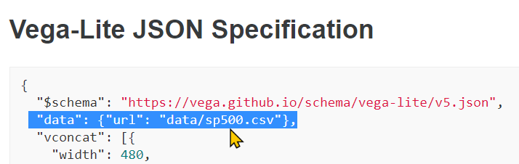

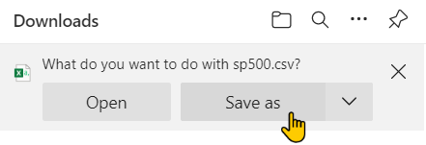
Getting a Vega example into Power BI
Download sample data file
Add https://vega.github.io/vega-lite/ before URL shown, like https://vega.github.io/vega-lite/data/sp500.csv
Paste into browser to download
Notes:
When I get a web sample, I find that it is easier to get it working if I try it with the same data as the sample. To do this on the Vega website, grab the partial URL from the code, and change the URL on the browser page. I just select all the text from “example/…” on, and paste in the partial URL from the code.
Save the file to your Downloads folder.
You don’t have to use the same file as the web sample, but it tends to be easier.

Slide 29
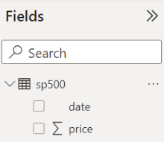
Getting a Vega example into Power BI
Load downloaded file into Power BI
Notes:
I don’t show the steps here, but load the csv file into your Power BI file.

Slide 30
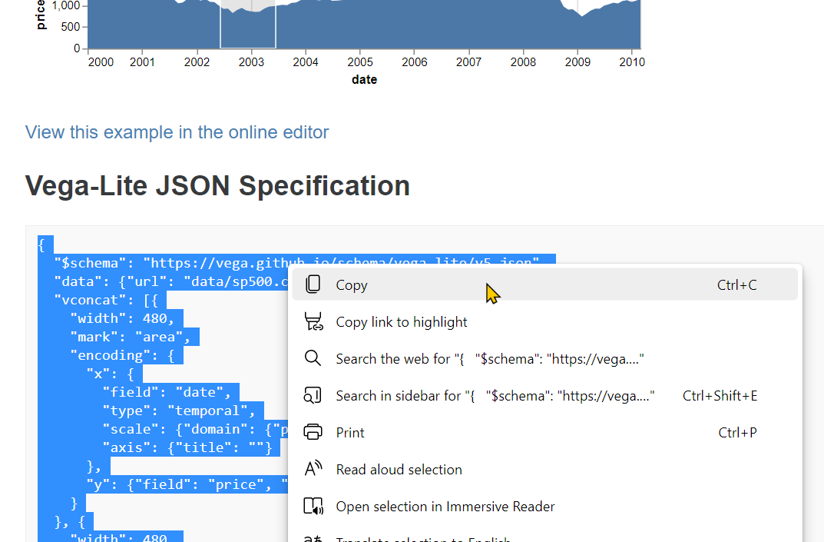
Getting a Vega example into Power BI
From the example web page, select and copy the code
Notes:
Next, grab the code from the website. Make sure you get everything from the starting left brace { to the ending right brace }.

Slide 31
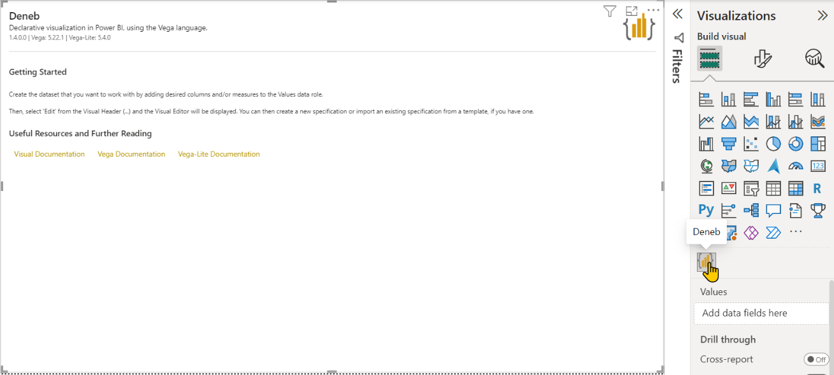
Getting a Vega example into Power BI
Add a Deneb visual in Power BI and resize it to fill the page
Notes:
Back in Power BI, click the Deneb visual icon to add it to your report page. Resize it.
No one every reads it, but this screen instructs you on the next step! There are also links to documentation right here.

Slide 32
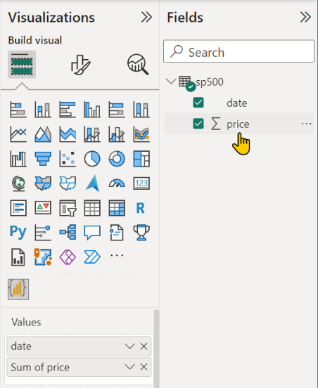
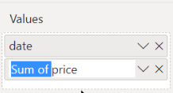
Getting a Vega example into Power BI
Check the boxes next to date and price to add them to the visual
Double click Sum of price in the Values pane to rename it to “price”
Notes:
The code editor won’t come up until you add data, but if you do the next step before doing this, again, the screen will tell you that you need to add data before the editor will show up.
In the slides, I’m showing you to rename the field. In the demo, I like to skip this step so you see what happens if you don’t match the names. Also note that Vega is case sensitive, so “data” works and “Data” with a capital D will not match the sample code and will not work.

Slide 33
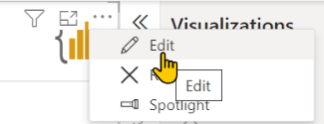
Getting a Vega example into Power BI
With the Deneb visual selected, click the 3 dots … and select Edit

Slide 34

Getting a Vega example into Power BI
Click Create for an empty file
TIP: You can use these samples too!
Notes:
Demo: show the samples that come with Deneb, and point out that you can save and import your own templates. This makes it easy to create your favorite charts and reuse them in other files. For implementing web samples, use the [empty] option and click Create.

Slide 35

Getting a Vega example into Power BI
Below the sample spec, paste in the example from the web
PASTE BELOW SAMPLE SPEC
SAMPLE SPEC
Notes:
When doing a web sample, paste the sample below the first 4 lines of code. We need to keep the data line as-is to integrate with Power BI.

Slide 36

Modifying Vega web samples for Deneb
Delete the highlighted lines
Deneb always uses "data": {"name": "dataset"}, to get Power BI data and ignores the $schema line.
Delete these lines
Notes:
Delete lines 3-7. Layer will be replaced by the web sample code. $schema tells Vega which version to use. In Deneb, the Vega version is set and you cannot change it, so delete $schema to avoid confusion. Then delete the data statement from the web code. You’ll use the Deneb data statement to get your data from Power BI.

Slide 37

Modifying Vega web samples for Deneb
By default, Deneb does not show you the impact of updates until you apply them through the “Play” button up top, or by pressing Ctrl + Enter.
You can also Auto-apply changes with the second button, or by pressing Ctrl + Shift + Enter
Notes:
After you’ve deleted those lines of code, you’d think the preview would show your chart, but you have to apply your changes first. The “play” button will apply the changes (or Ctrl + Enter). I always forget to do this and I’m confused when my changes don’t work, so I prefer to use the Auto-apply button. The negative to Auto-apply is that the preview will show as an error when you are in the middle of making a change. If that bothers you, stick to the Apply button. (This will be demoed as further changes are made).

Slide 38

Modifying Vega web samples for Deneb
In most cases, if you’ve followed these steps correctly, the sample should be working at this point
Use the Zoom controls to resize your visual in the preview pane
The dotted lines indicate the “visual container” in Power BI
Zoom controls
Zoom to fit
Notes:
When I do the demo, I’ve not renamed “Sum of price” to “price” yet, so the axes show up, but the area chart doesn’t. It’s a good teaching moment to show that the names have to match exactly.
I don’t cover the “Field Mapping” button (two arrows) here. Sometimes the mapping button shows all the fields, and sometimes it doesn’t. So for the simple demo, I just say “match the names as you see in the code” and I point out the word “field” to show where the names are set in the code.
Field mapping often helps you update the code when field names change. Often, you don’t even need to press the button, the screen just sees the fields changed and it pops up for you. It has the old names on the left and a drop down of the current fields. Map them and Deneb renames the fields in the code for you.

Slide 39

Modifying Vega web samples for Deneb
Click Back to report to return to Power BI when done

Slide 40


Modifying Vega web samples for Deneb
Specs are in JSON format
Keys and values are separated with a colon :
Keys and strings are put between double quotes " "
Numbers are not put between quotes
Lists (aka arrays) are put between square brackets []
Objects are put between curly brackets {}
Use triangles to expand/collapse sections
Use Repair and Format JSON option to make code more readable or fix errors
Notes:
This is the only slide I don’t cover in the demo. It’s a good reference for getting started with Vega, but is best handled in a tutorial like the one I pulled it from. I leave it here as reference for people after the presentation.
From Data Visualisation in Data Science | Data Visualisation in Data Science (vda-lab.github.io)

Slide 41
Modifying Vega web samples for Deneb
Modifying
Size
Tooltips
Titles
Formatting
Switching to your data
Notes:
I demo adding titles to the charts. As I always say: “Titles are the most important part of the chart. Without a title, a chart is just a squiggly line.” You can quote me on that.
Vega doesn’t have comments. The closest thing it has is the “description” keyword. You can and should always use this at the top of your Vega code, and then along with each “mark” in the code. As you layer a line, and points, and labels, it makes it easier to figure out the purpose of each mark. Also when you copy code from the Internet, be sure to include a link to the webpage in the description so you can find help if you need it and credit your source.
I also demo the config tab. This is your style sheet. It’s great because if you want a common look across your charts, just set the styles up and paste them into the config tab. If a particular chart needs to be different, override it in the code. I add “title”: {“fontSize”: 18}, to show how to make titles (the most important part of a chart) stand out more. I then add “color”: “red, to show how to change the color in a way that you can tell that it worked, and then I modify it using a web color code like “#ffcc00”. I then copy the color code and add it to the “area” settings. It highlights that an area chart has a line, and to turn it off, I set its config to false.
My Deneb sample file has the final version of this demo.

Slide 42
Q+A

Slide 43
Deneb Resources

Slide 44
Deneb resources
Demos
Vega Lite Demo
Deneb - Introduction
Deneb Demo
Help
Deneb Help
Vega-Lite Documentation
Vega-Lite Tutorial
Notes:
Of course there’s a lot out there, but these are my favorites.
The Vega-Lite demo shows the “art of the possible” using Vega.
The “Deneb” videos show Power BI.
The help links show the definitive sites for Deneb and Vega. You won’t have to search many other sites like for R and Python. These sites are very comprehensive for how to use Deneb and Vega.

Slide 45
Deneb resources
Vega examples:
Example Gallery | Vega-Lite
Deneb examples:
David Bacci's Deneb Showcase
Kerry Kolosko’s blog – Explorations in Data Storytelling with Power BI
Forums:
Stack Overflow - Deneb
Stack Overflow – Vega-Lite
Notes:
I think all the examples except maybe one on the title slide come from these three websites.
David has great animation examples and the variance chart.
Kerry’s website has great KPIs, the raincloud chart, and shows how to use images in your charts.
For help, StackOverflow is a great place to ask questions. Use Deneb for Power BI specific issues, or Vega-Lite for code specific issues. It’s also not bad to look at what’s out there to get a sense of how other people are using Deneb.

